Slide 1
Group 8: Scalable Matrix Multiplication Accelerator
羅允辰, 李冠霈, 王睿瑄
高階合成技術於應用加速-Final Project

Slide 2
Outline
Overall Procedure
HLS Code Analysis
Memory-related
Compute-related
Empirical Results
Conclusions

Slide 3
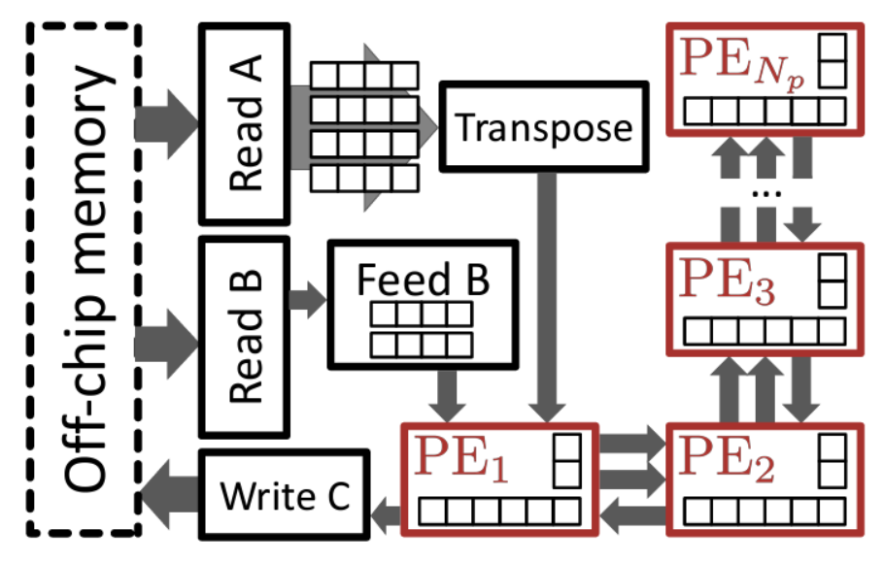
Overall Procedure
Initialize OpenCL & others
Copy matrix (host→device)
Execute Kernel
Copy result (device→host)
5. Compute golden on host
6. Verify the result
③
FPGA+HBM
Host
②
B
⑤
C
A
=
⑥
C
④

Slide 4
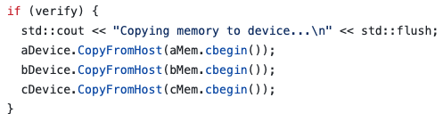
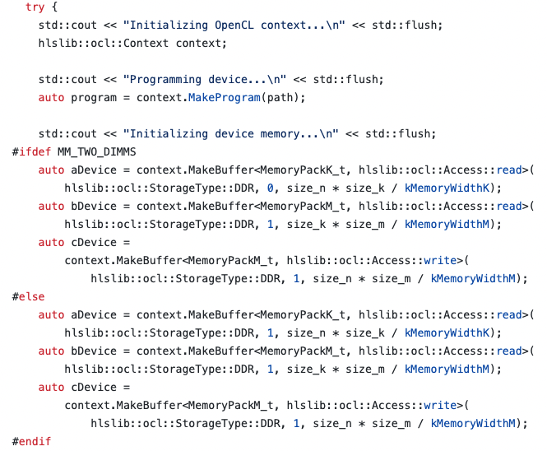
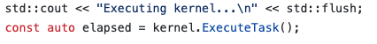
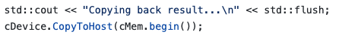
Overall Procedure
②
①
③
④
③
FPGA+HBM
Host
②
①
B
⑤
C
A
=
⑥
C
④

Slide 5
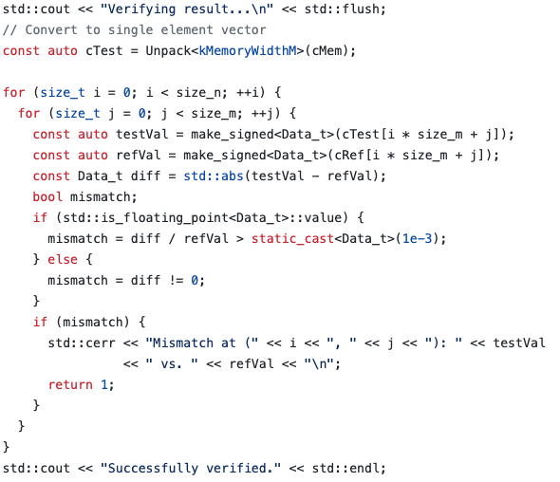
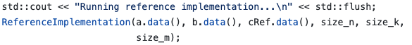
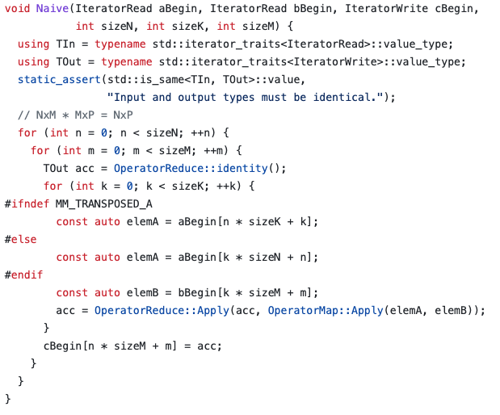
Overall Procedure
⑥
⑤
③
FPGA+HBM
Host
②
①
B
⑤
C
A
=
⑥
C
④

Slide 6
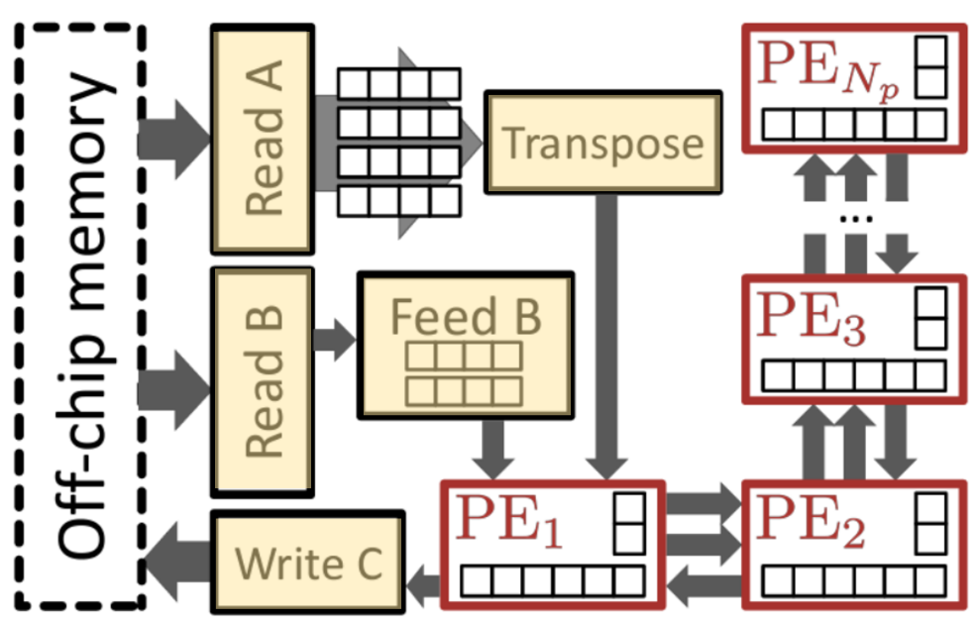
Memory-related

Slide 7
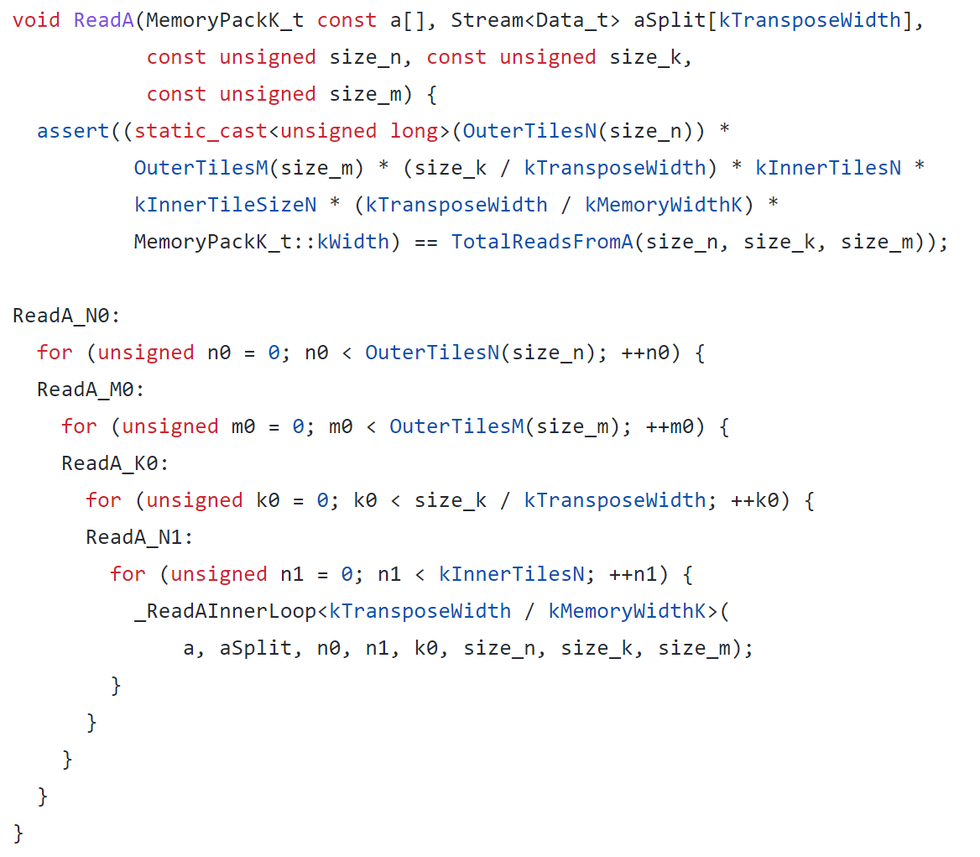
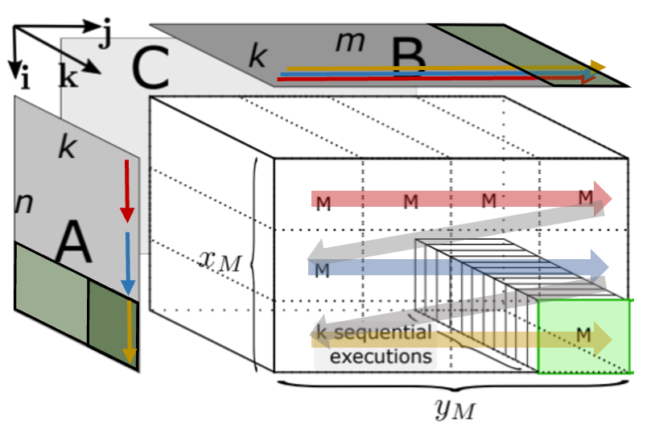

Read A

Slide 8
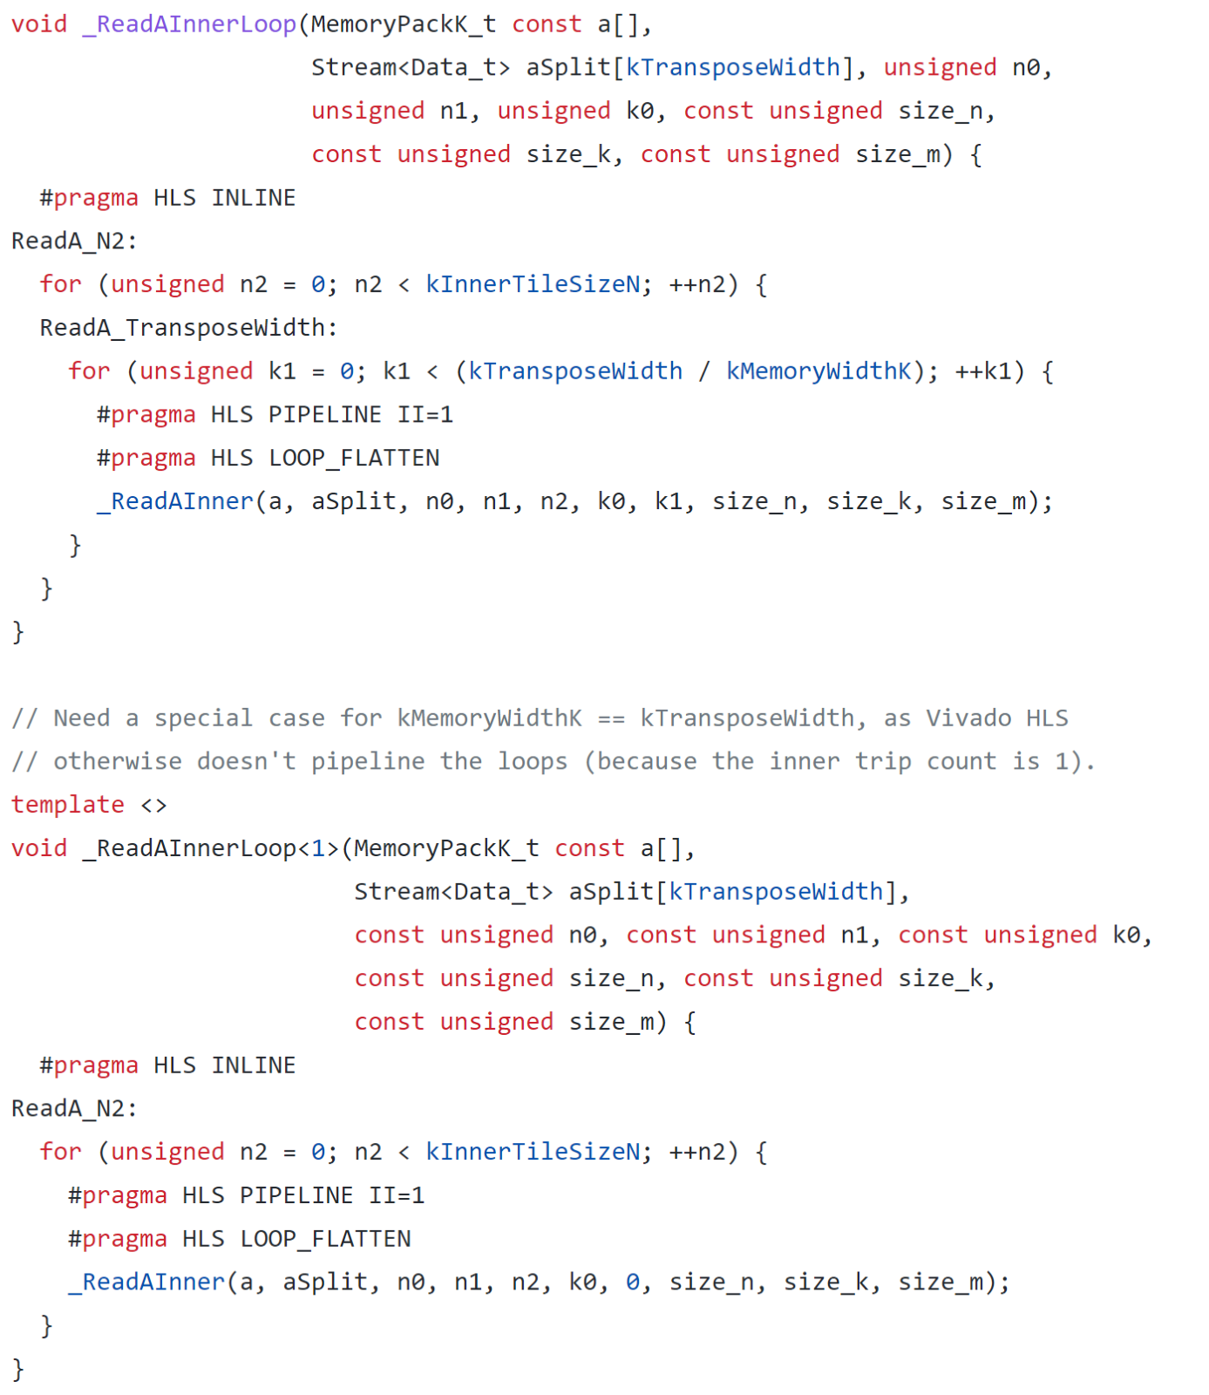
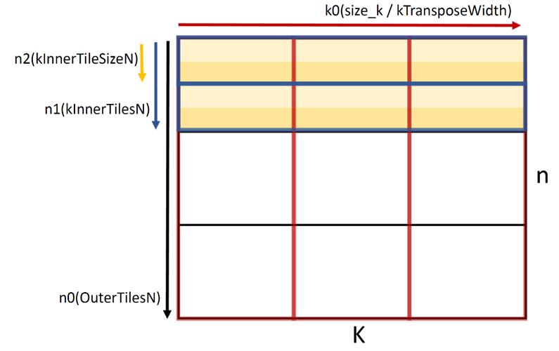
Read A
A

Slide 9
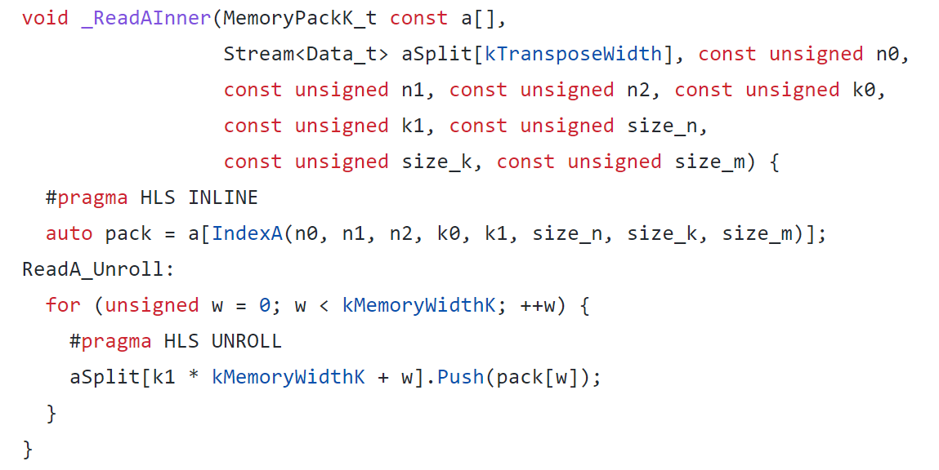
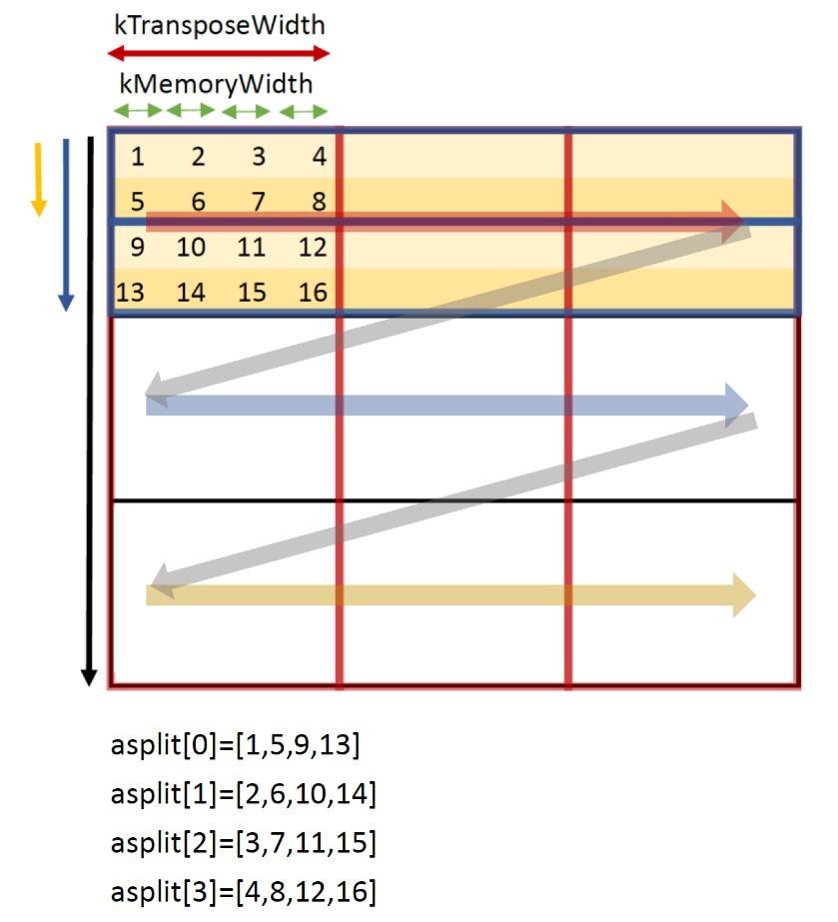
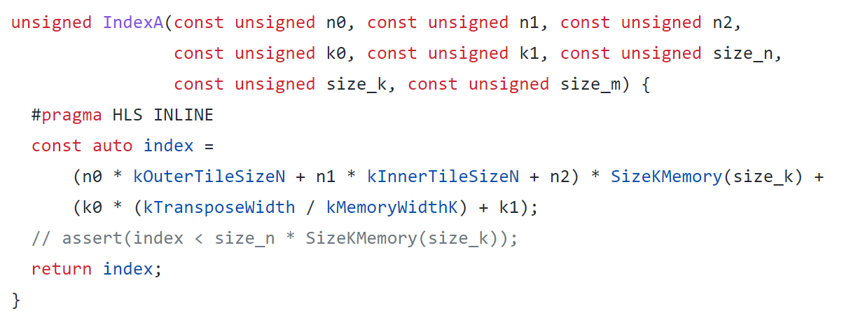
Read A
A
n
k

Slide 10

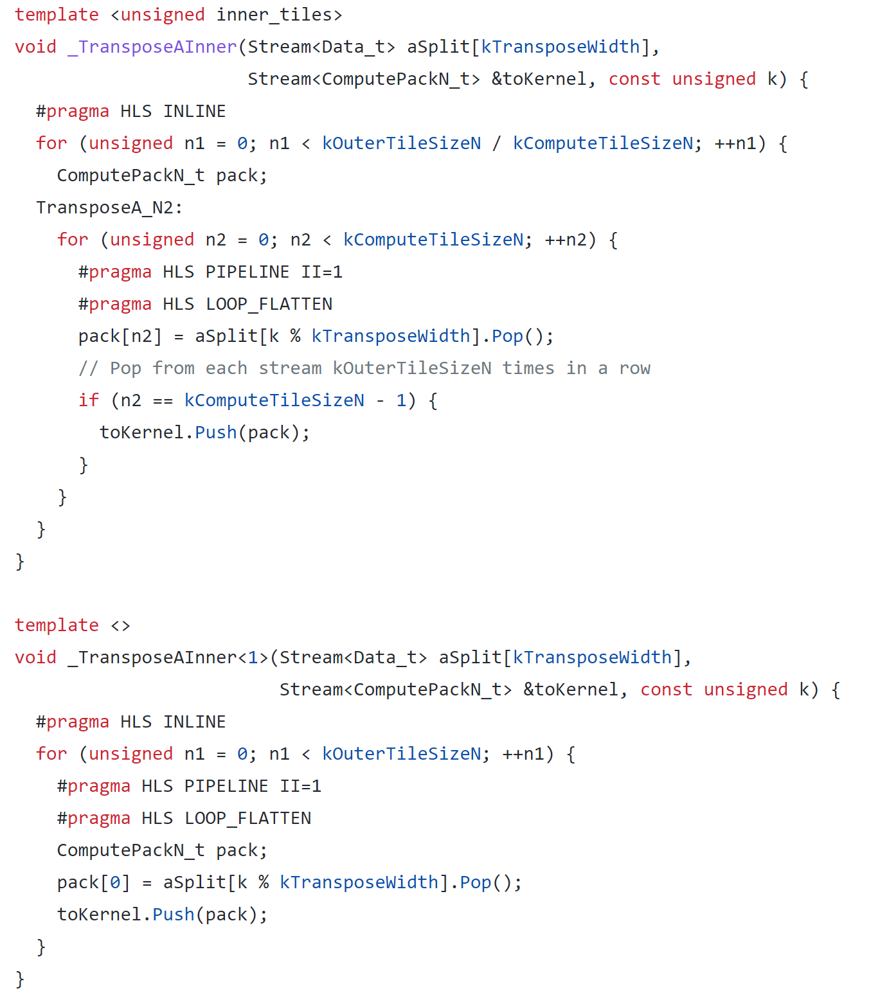

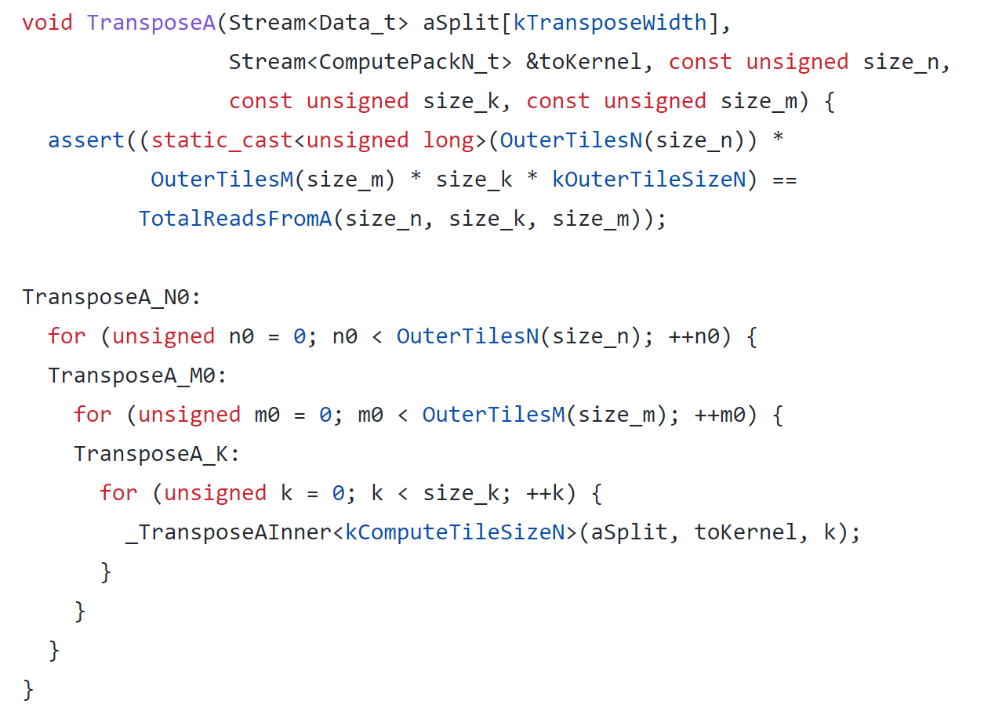
Transpose

Slide 11
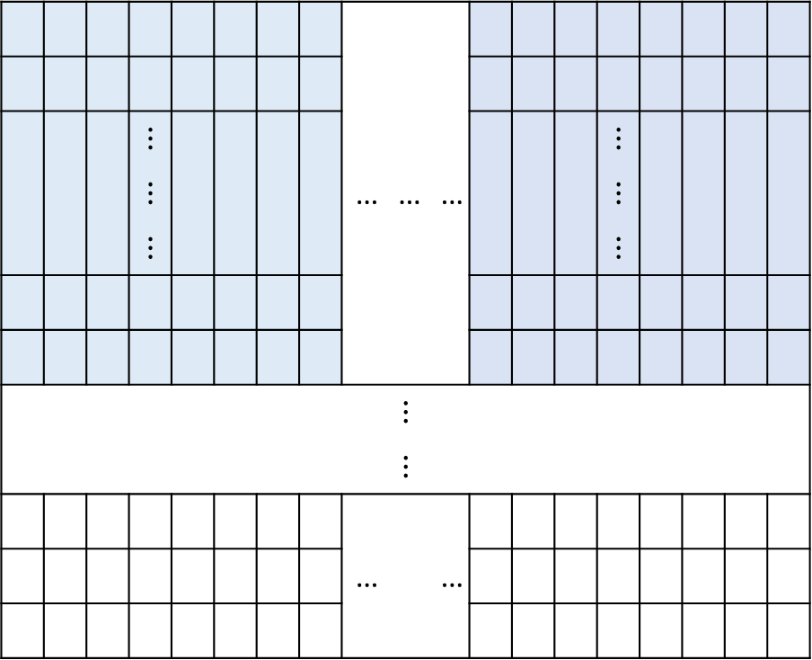

Read A & Transpose Cycle
128
Bottleneck :
Transpose cycle =512$×$128$×$8$×$4=2097152
8
 |  |  | $$⋮$$ |  |  |  |  |  |  |  |  |  |  | $$⋮$$
 |  |  | $$⋮$$ |  |  |  |  | … | … | … |  |  |  | $$⋮$$
 |  |  | $$⋮$$ |  |  |  |  |  |  |  |  |  |  | $$⋮$$
 |  |  |  |  |  |  |  |  | $$⋮$$
 |  |  |  |  |  |  |  |  | $$⋮$$
 |  |  |  |  |  |  |  | … |  | …
512
1024

Slide 12
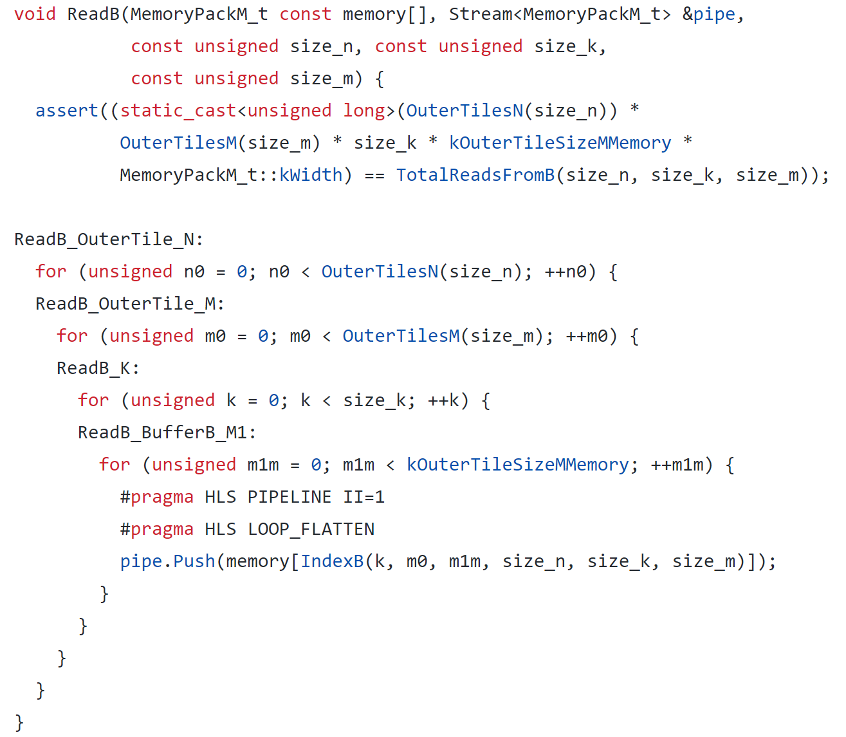
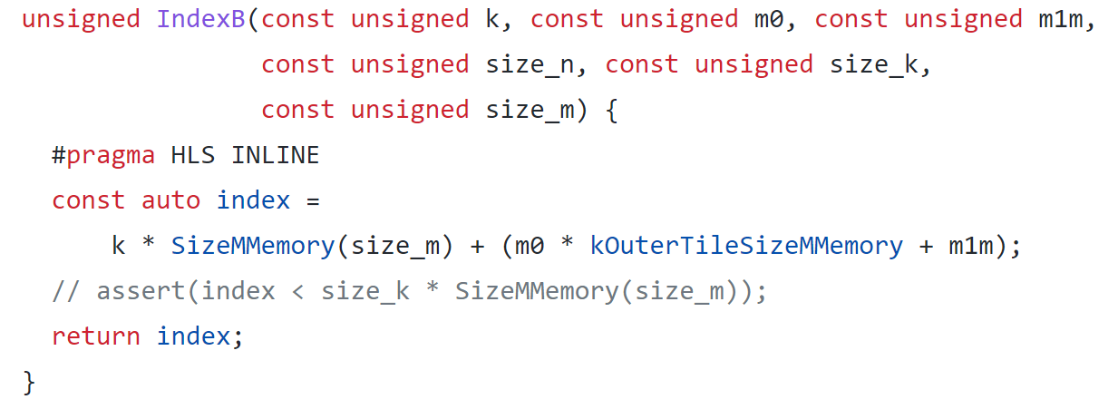
Read B

Slide 13
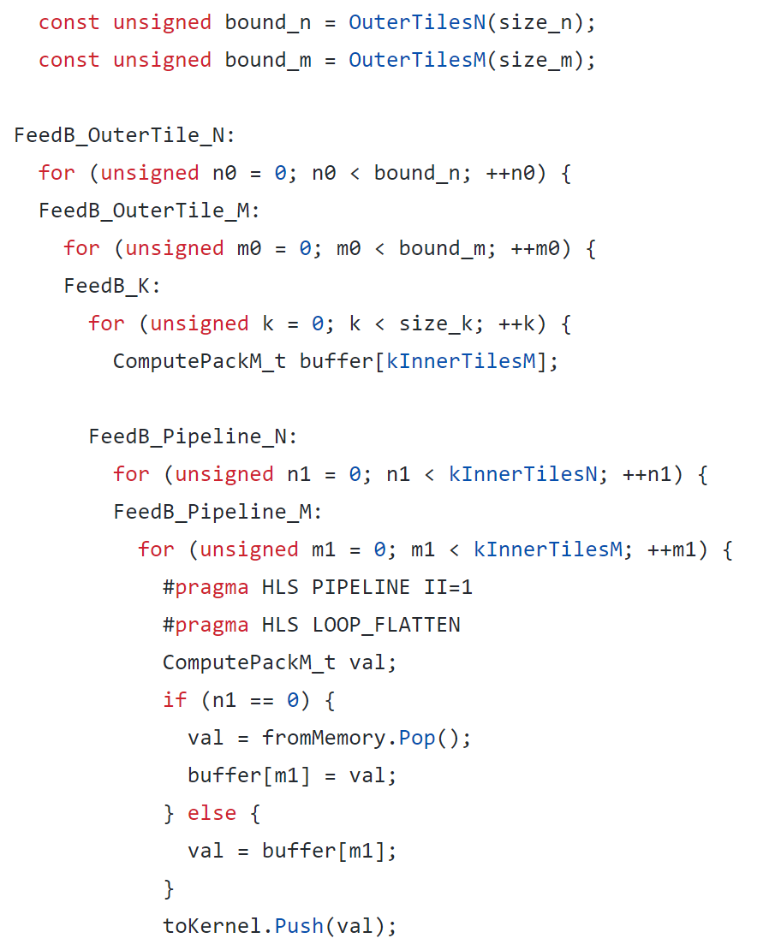
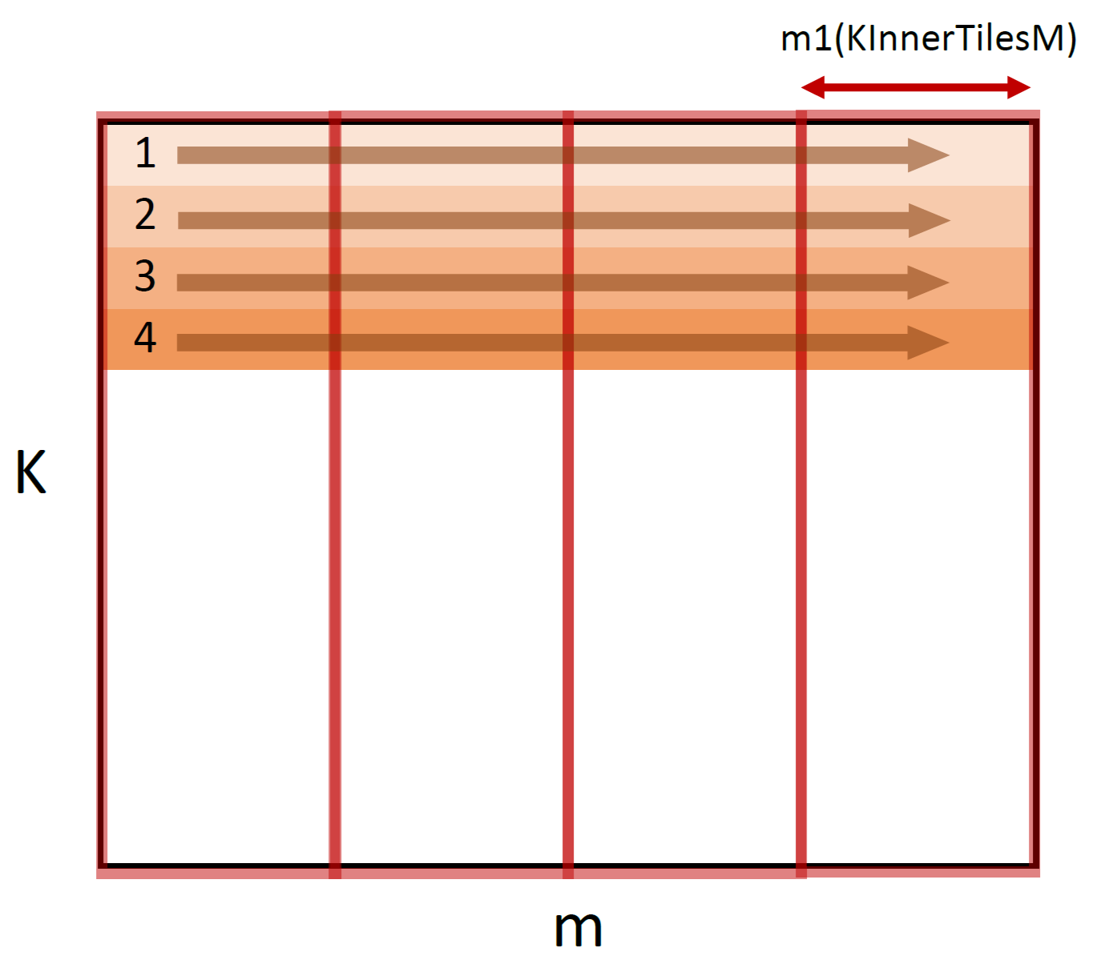


Feed B
Read B cycle : 2$×$2$×$1024$×$64=262144

Slide 14
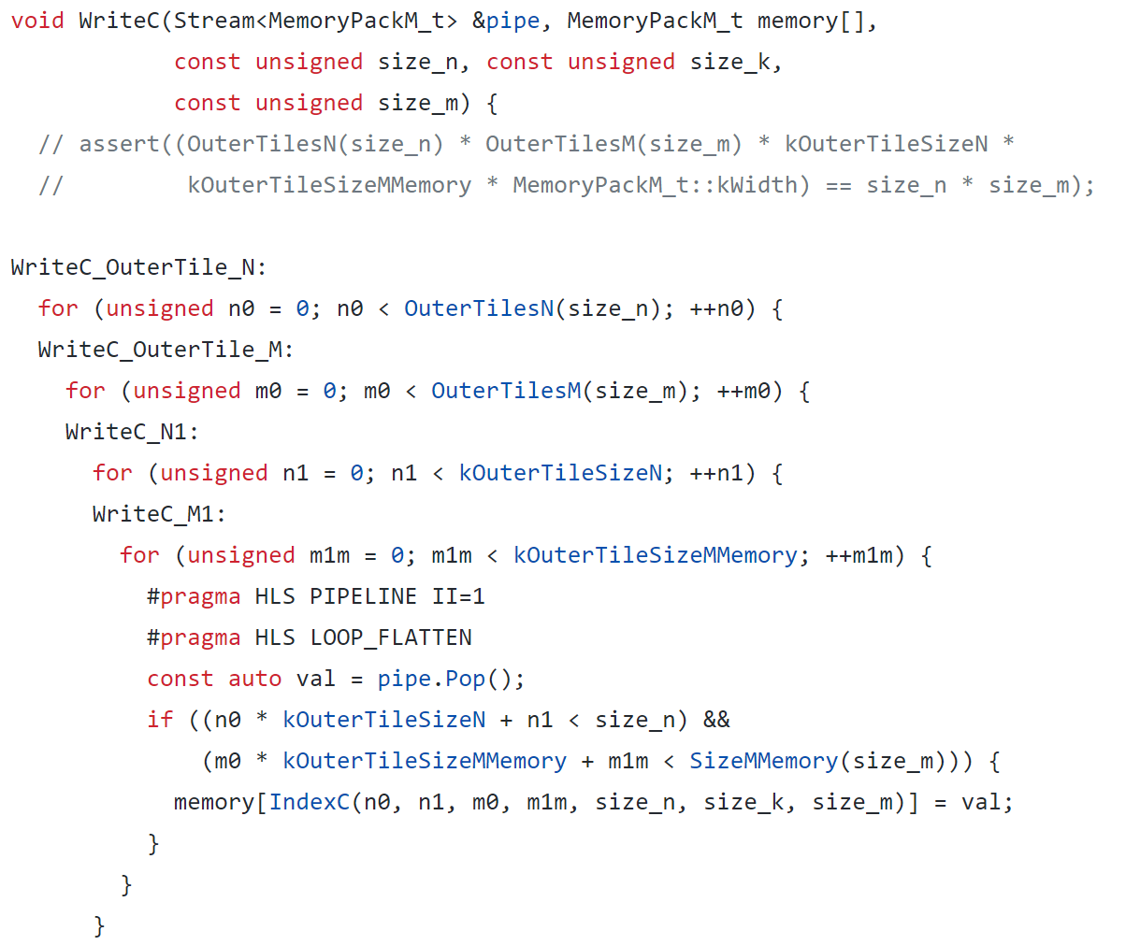
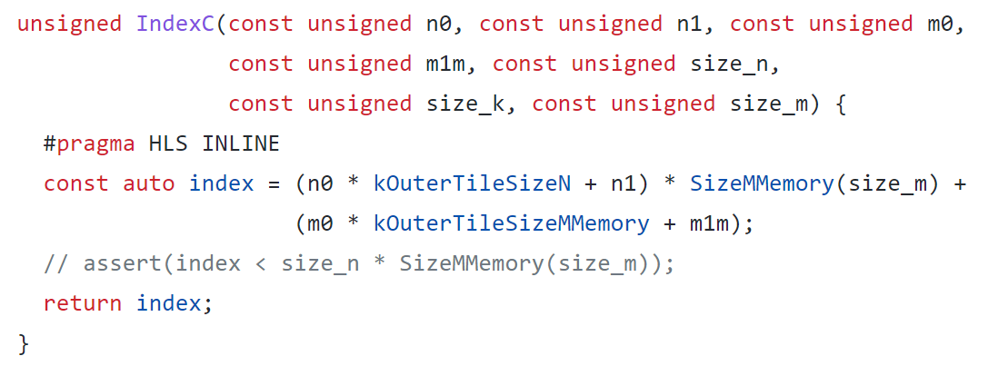

Write C
Write C cycle : 2$×$2$×$512$×$64=131072

Slide 15
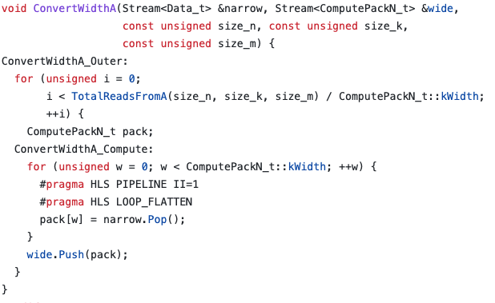
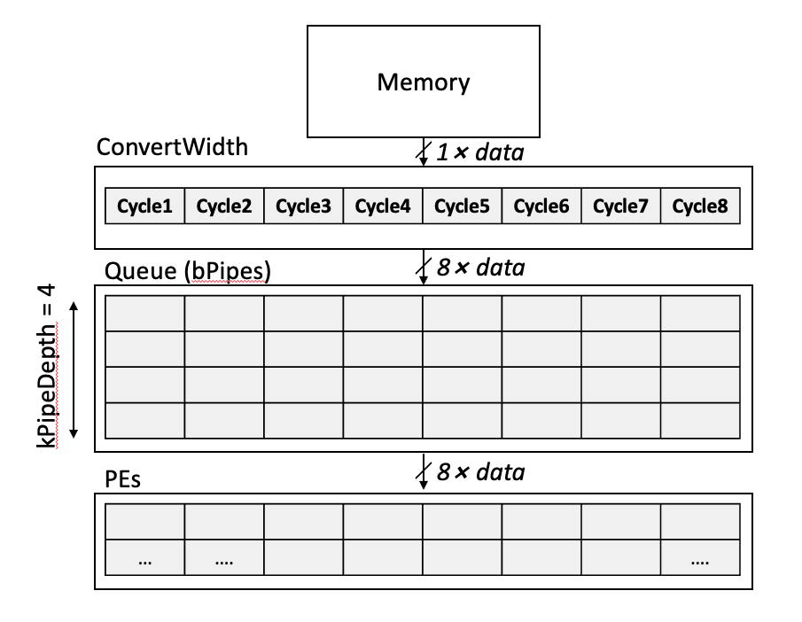
Convert Bitwidth

Slide 16
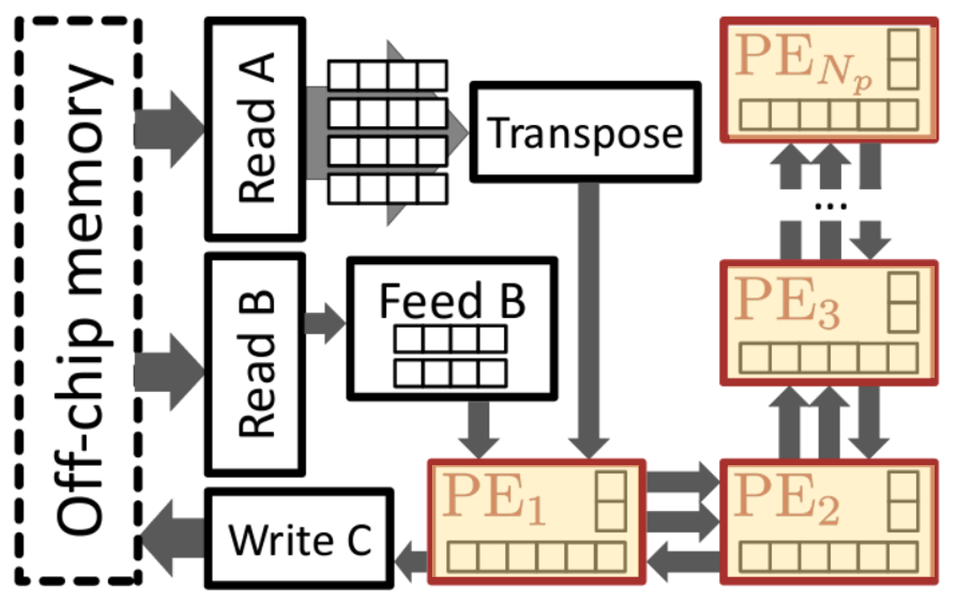
Compute-related

Slide 17
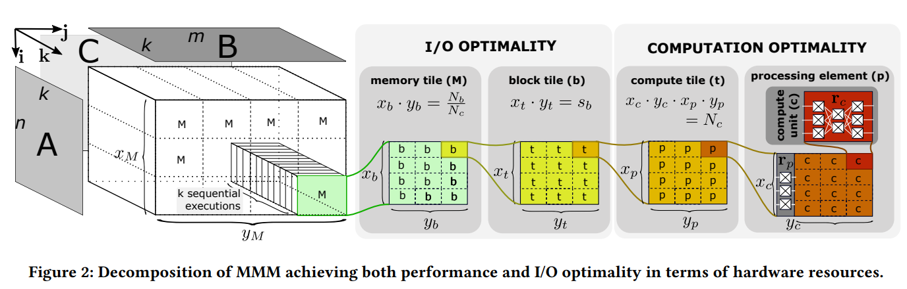
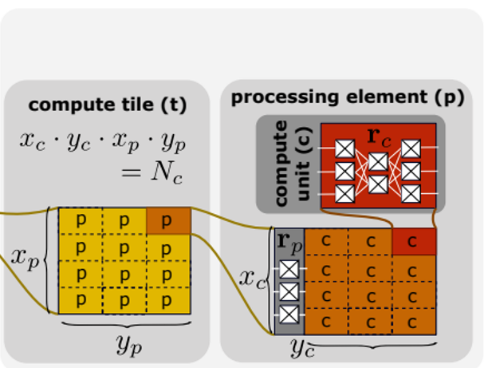
Processing Elements
64
kInnerTilesM
8
kComputeTileSizeM
512 kOuterTileSizeM
kComputeTileSizeN=1
kOuterTileSizeN
512
kInnerTilesN
16
kComputeTilesN
32

Slide 18
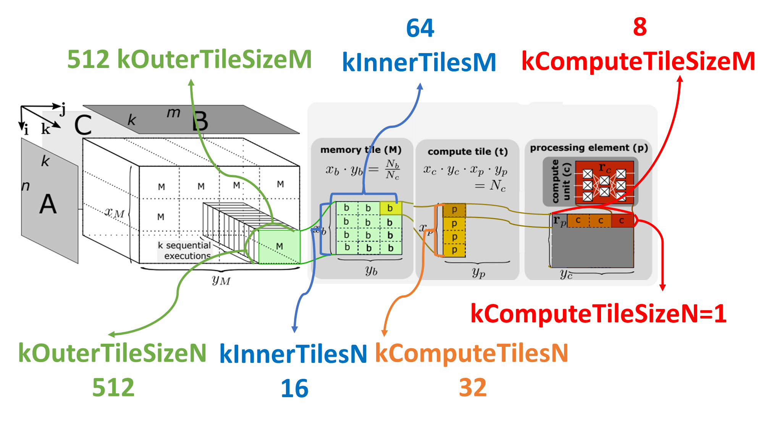
Total Internal Buffer Size
For an outer tile:
A: 512*1024 (n x k)
B: 1024*1024 (k x m)
C: 512*512 (n x m)
Each data has 8 byte
Matrix | Size (MB)
A | 4.194304
B | 8.388608
C | 2.097152
Total | 14.680064

Slide 19
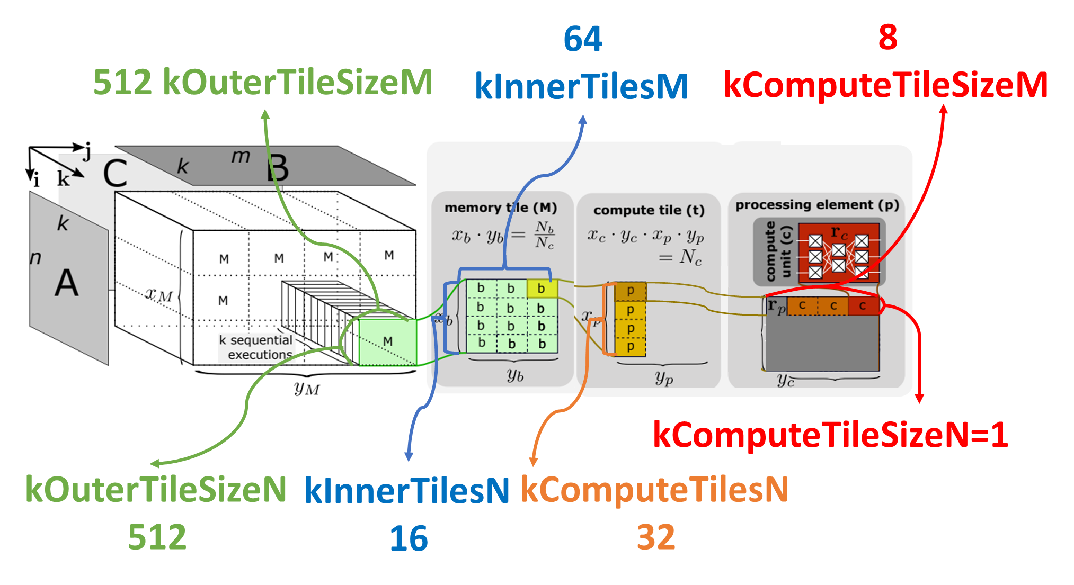
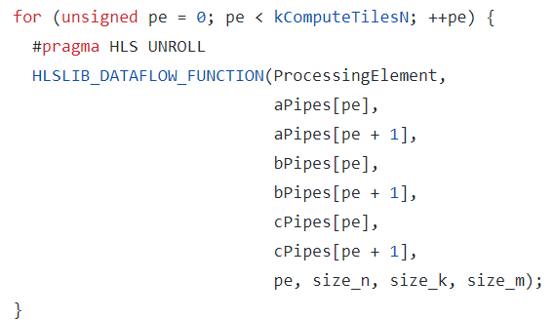
Processing Elements
aPipes[0]
aPipes[1]
aPipes[31]
bPipes[0]
bPipes[1]
bPipes[31]
PE1
PE2
PE32
cPipes[0]
cPipes[1]
cPipes[31]

Slide 20
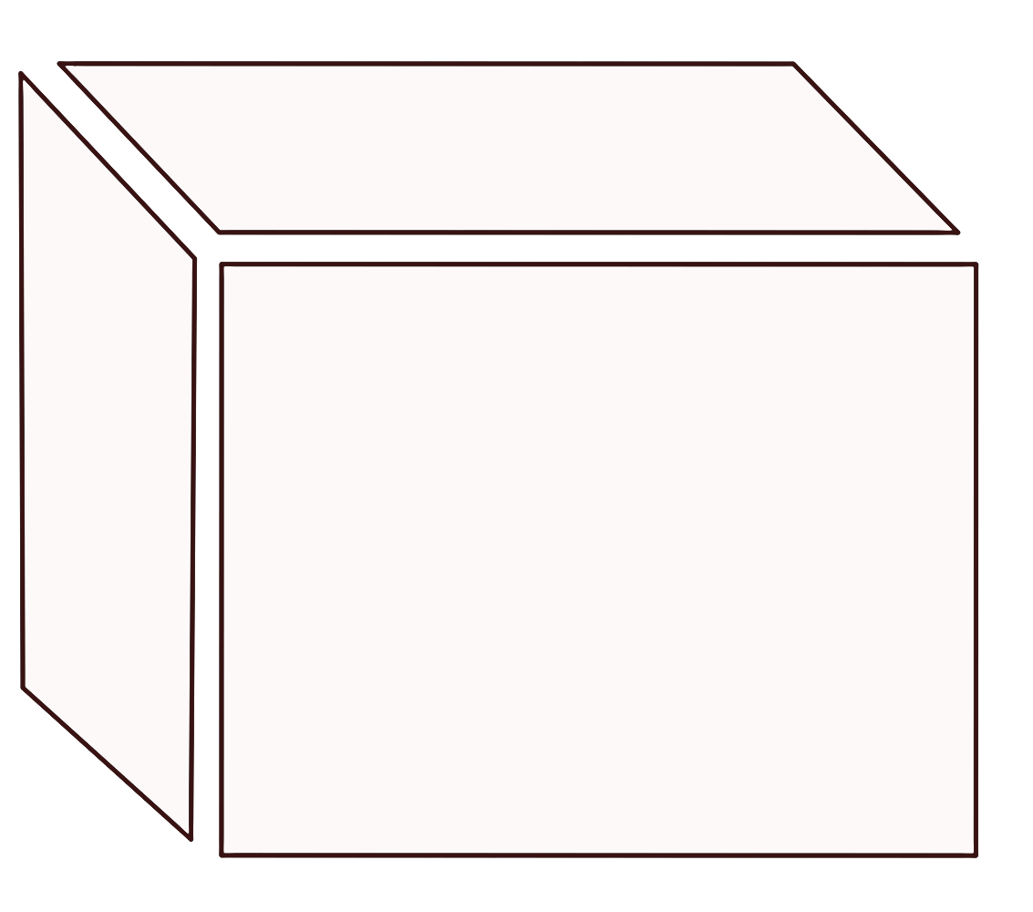
Processing Elements
m=1024
m0
④
n=1024
B0
B1
B2
A0
⑤
A0B0
A0B1
A0B2
③
A1
k
A1B0
A1B1
A1B2
n0
A2
A2B0
A2B1
A2B2
m1
①
A0
A1
B0
B1
B2
B7
k=1024
A32
A0
(A1024)
c0
c1
c2
c7
PE1
②
A33
n1
A1
(A1025)
c0
c1
c2
c7
PE2
A31
(A1055)
c0
c1
c2
c7
PE32

Slide 21
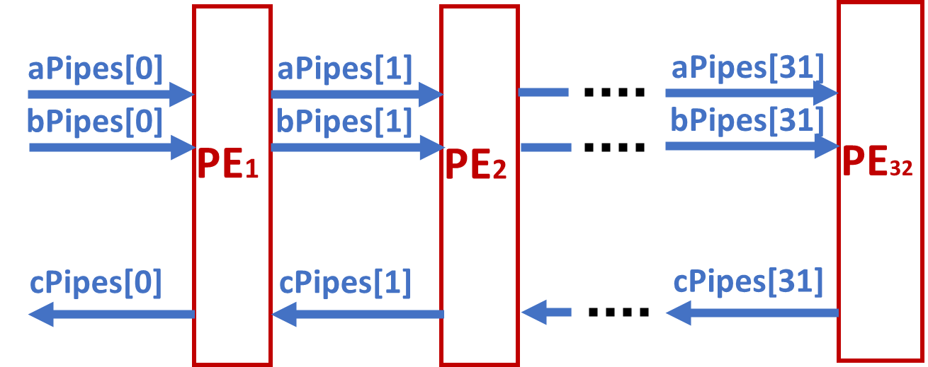
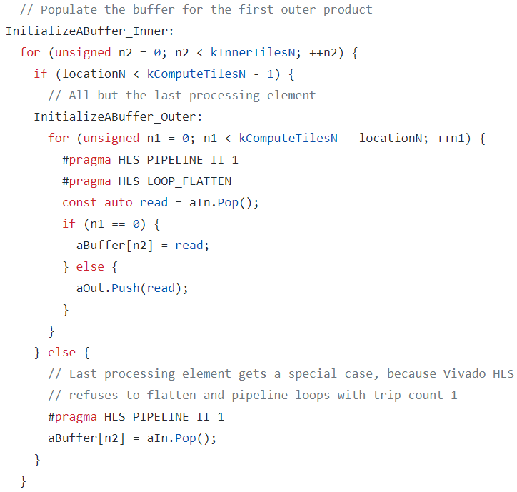
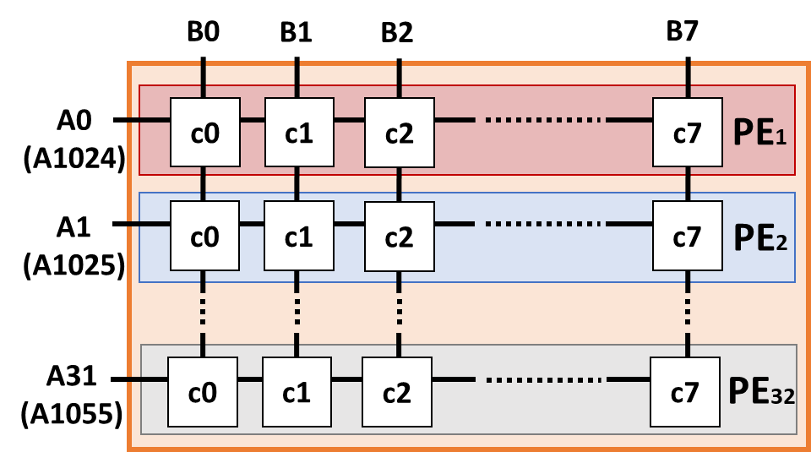
Processing Elements Initialize
k 1024
A0
A1024
n
1024
A1
A1025
aPipes[0]=[0,1,2,3,4,…,511, 1024, 1025,…]
PE1
aBuffer[32]=[0, 32, 64, 96, ……, 480, 0,…, 0, 0]
aPipes[1]=[1, 2, 3, …, 31, 33, …, 481, 482, …, 511]
PE2
aBuffer[32]=[1, 33, 65, 97, ……, 481, 0, …, 0, 0]
aPipes[2]=[2, 3, …, 31, 34 , …, 482, …, 511]

Slide 22
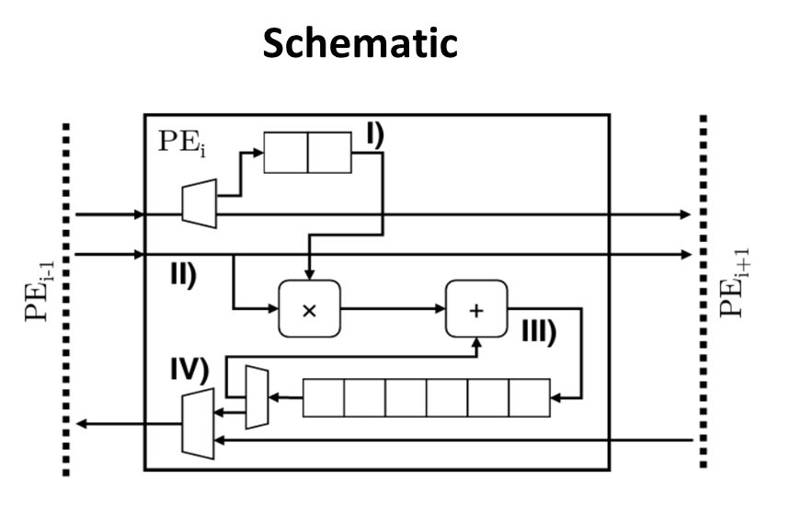
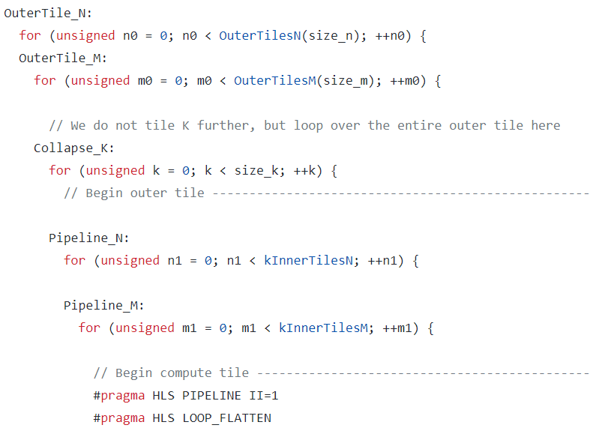
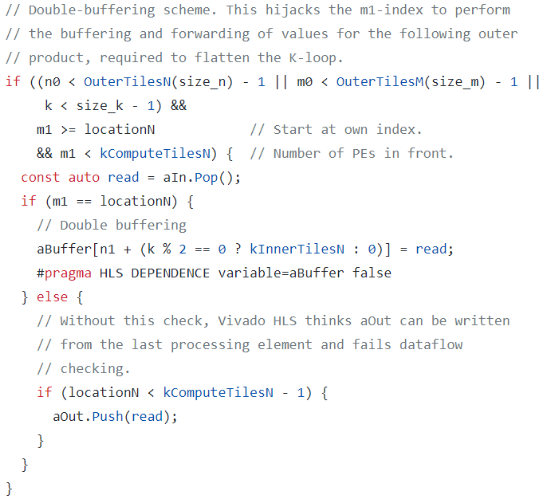
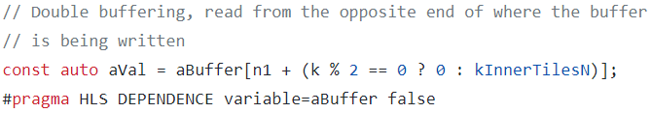
Processing Element Part I
Odd k
Even k
aVal
Even k
Odd k
PE1
aBuffer[32]=[[0], [32], [64], [96], ……, [480], [1024],…, [1472], [1504]]
aPipes[1]=[1, 2, 3, …, 31, 33, …, 481, 482, …, 511, 1025, 1026, …, 1505, 1506, …, 1535]
PE2
aBuffer[32]=[[1], [33], [65], [97], ……, [481], [1025],…, [1473], [1505]]
aPipes[2]=[2, 3, …, 31, 34 , …, 482, …, 511, 1026, …, 1506, …, 1535]

Slide 23
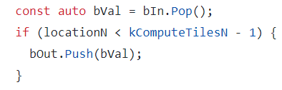
Processing Element Part II
bVal
bIn size = kComputeTileSizeM = 8
m1=0
bVal = [0, 1, 2, 3,….., 7]
bPipes[1]=[0, 1, 2, 3,….., 7]
m1=1
bVal = [8, 9, 10, 11, …, 15]
bPipes[1]=[[0, 1, 2, 3,….., 7], [8, 9, 10, 11, …, 15]]

Slide 24
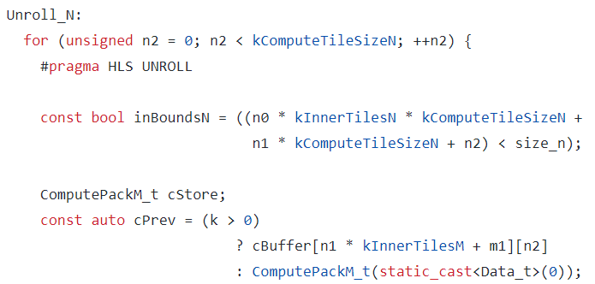
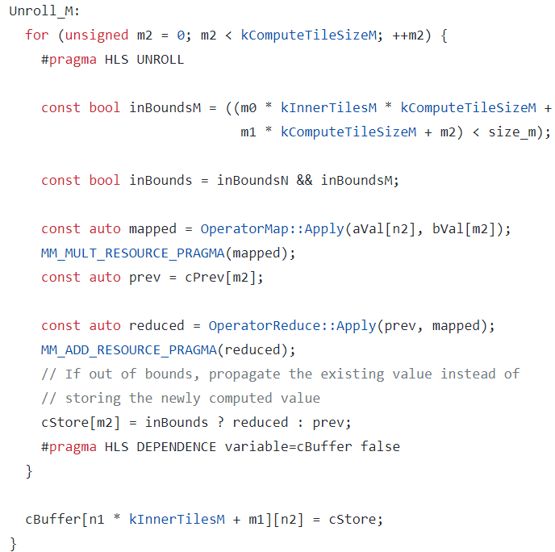
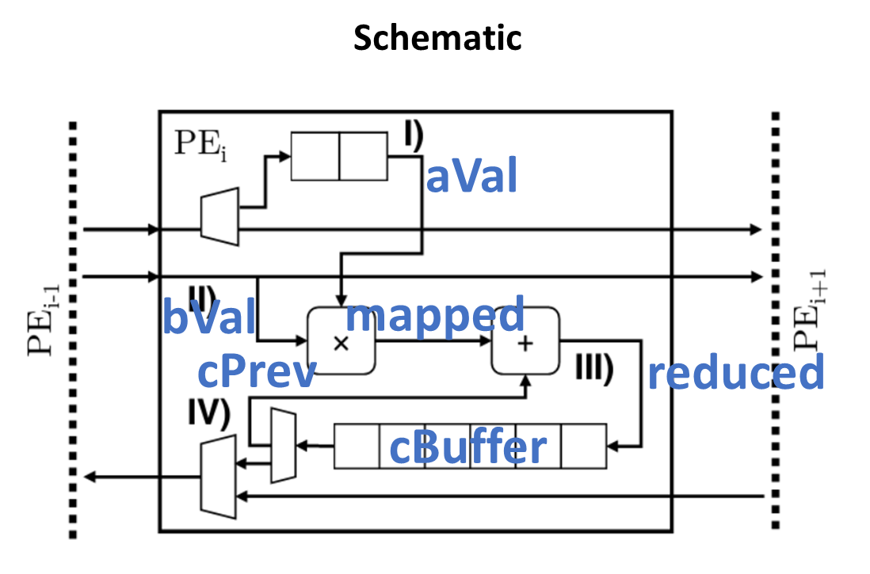
Processing Element Part III

Slide 25
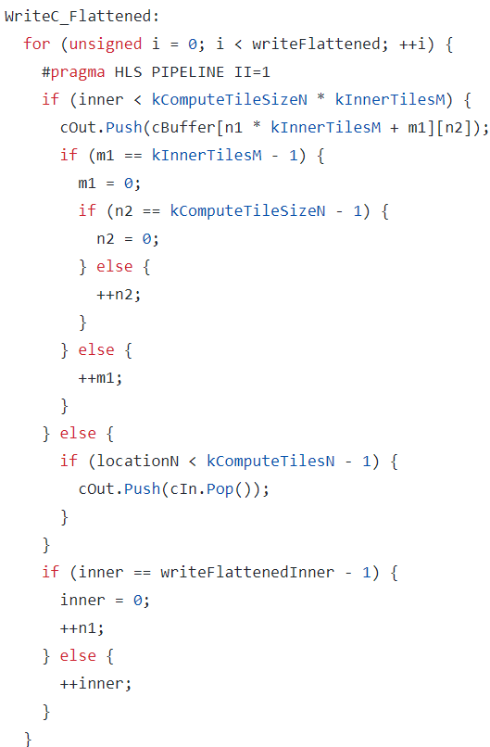
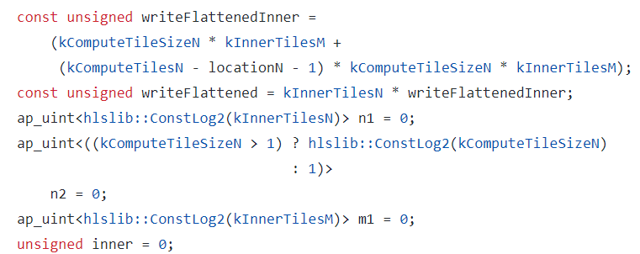
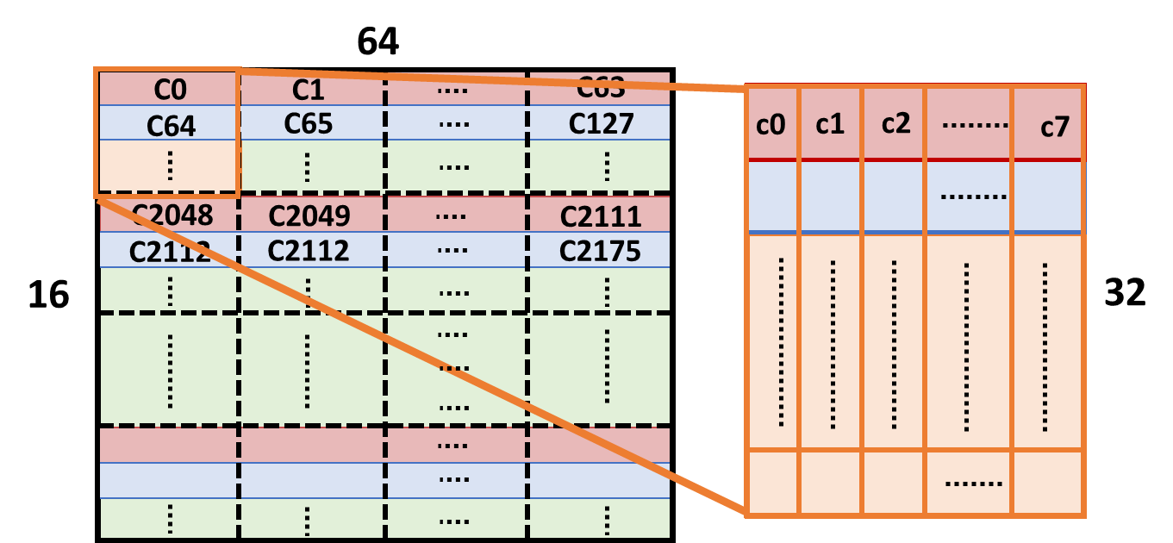
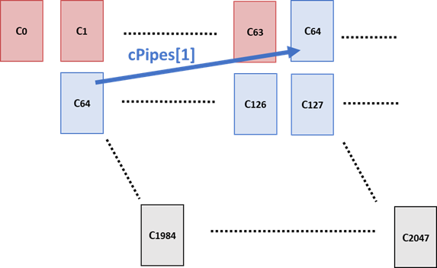
Processing Element Part IV

Slide 26
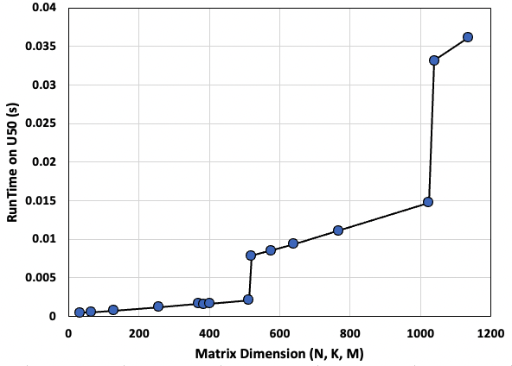
Empirical Result - Runtime

Slide 27

Empirical Result - Throughput

Slide 28

Conclusions
This scalable GEMM architecture partitions matrix into tiles to support various matrix multiplication workloads
We thoroughly study the HLS code structure to understand the architecture and how to design it
We successfully port accelerator to U50 board
We run extensive evaluations to find potential optimizations

